Slide 1

Final Presentation
By:
Dheeraj Singh
Vidhika Jain
Ashish Bachuwar

Slide 2
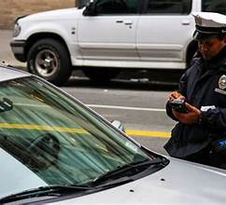
Table of Content
Introduction
Target Audience
Project Sponsor
3 Minute Story
Dashboard

Slide 3
Introduction
The dataset that tells the stories of millions living in New York City struggling to follow the parking rules and regulations due to various influencing factors throughout the city. This dataset provides data on Parking Violations Issued between July 04, 2022, to January 16, 2024, and insights into the types and frequency of violations during this period.
What our team learned is that the dataset doesn't reflect the current status of violations, it only represents the violations as of the time they were issued. Since violations listed in the dataset may have undergone changes in status since issuance.
Target Audience
aaaa

Slide 4

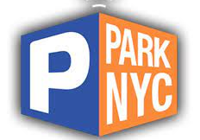
Project Sponsor
Name: Dr. Oliver Quantum
Title: Director of Department of Transportation, Parking Enforcement, City of New York
Position: Director of Legal Affairs Division, Parking Enforcement
Vision: Leverage data insights such as identifying patterns, trends, and areas of concern related to parking violations to enhance the efficiency of parking enforcement operations while ensuring compliance with parking regulations and legal requirements.

Slide 5
3 Minute Story
In New York City, parking can be a real challenge. Between July 4, 2022, and January 16, 2024, over 5 million parking violations were issued. This data is about how people park and where they're most likely to break the rules.
In our analysis, we discovered that Manhattan had comparatively way more tickets than other boroughs, which was fair enough considering the population, tourists that visit compared to other boroughs. We were keen on learning/gaining more insights as to why Manhattan was trending high in parking violations, in other words, we were interested in finding the top 5 violation codes/types. We found some useful information that ‘No Parking-Street Cleaning’ was the most violated amongst the others. However, Manhattan had a lot of precincts, and our analysis aimed to pinpoint violations as accurately as possible, this made us consider the top 5 precincts in Manhattan which were 14, 13, 18, 19, and 17. Our team was also keen in knowing what time of the day played a vital role in increased parking violations in these precincts, and we found that the violations tend to start from as early as 6 AM and continue to be steady until 2 PM, and after that the violations gradually started to decrease. Another key finding was people who travelled in passenger vehicle type had way more parking violations compared to commercial vehicles.
To address the high parking violations in Manhattan, we suggest focusing on targeted enforcement in top precincts during street cleaning hours and peak violation times from 6 AM to 2 PM. Providing more affordable parking options and better public transportation can also help ease the parking pressure. Lastly, raising awareness about parking rules, especially for passenger vehicle owners, could encourage compliance and reduce violations.

Slide 6
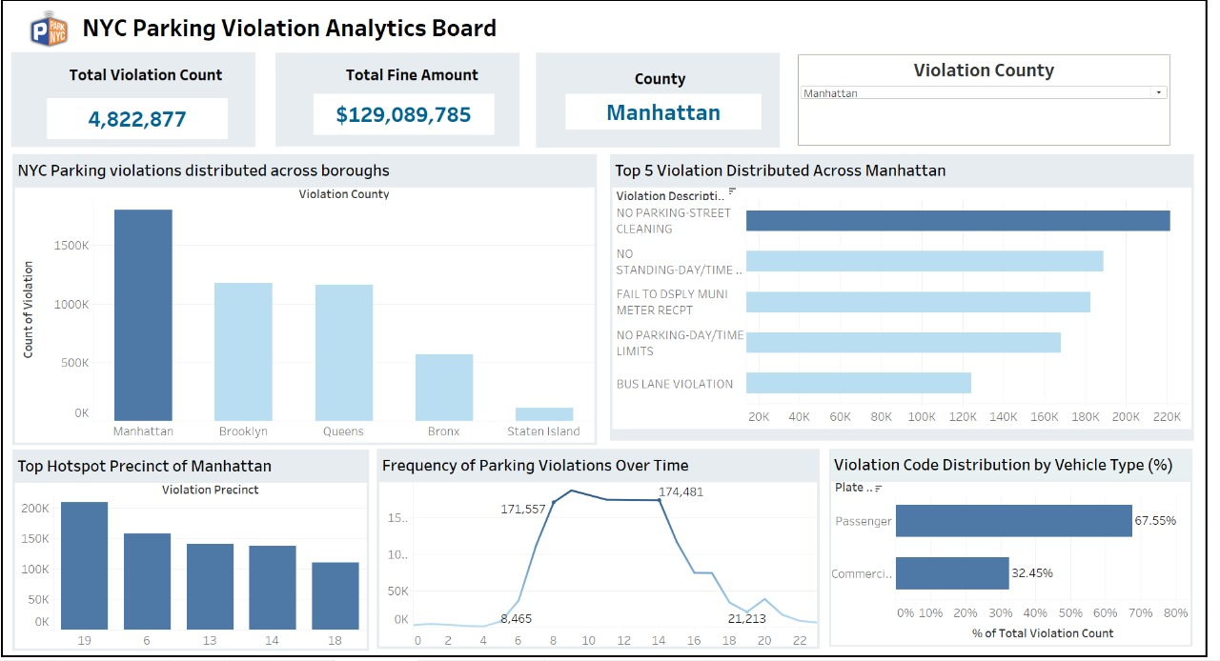

Slide 7
Calls to Action
We suggest focusing on targeted enforcement in top precincts during street cleaning hours and peak violation times from 6 AM to 2 PM.
Providing more affordable parking options and better public transportation can also help ease the parking pressure.
Lastly, raising awareness about parking rules, especially for passenger vehicle owners, could encourage compliance and reduce violations.

Slide 8
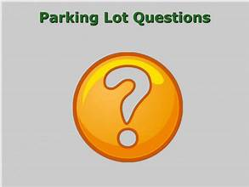

Slide 9
Thank You

